Slide 1



Activity Booklet: Geometric Bodies
Designed by Slidesgo

Slide 2
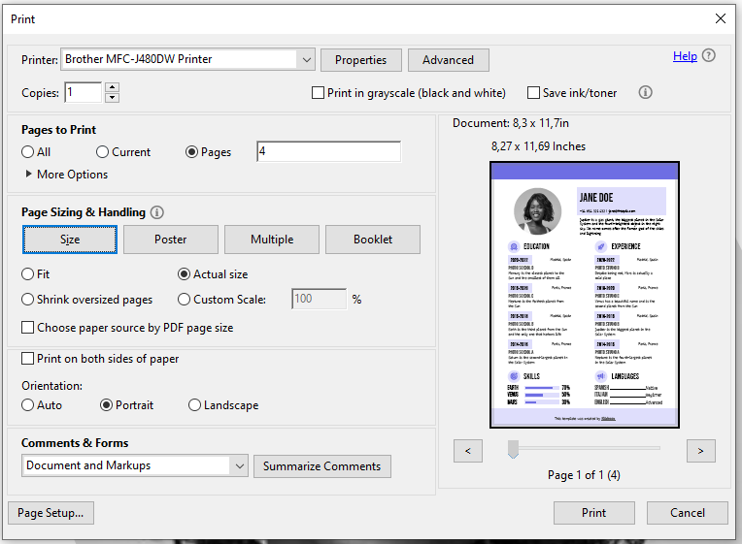
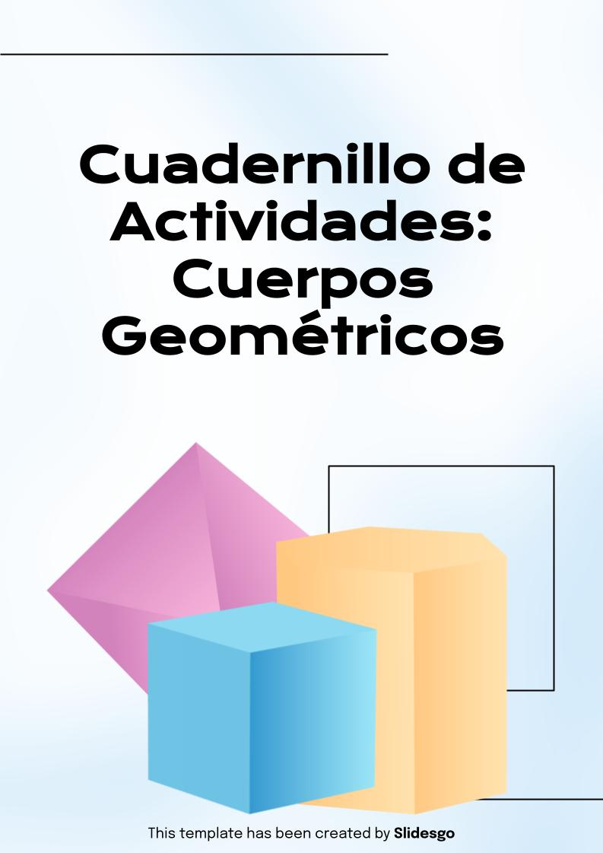
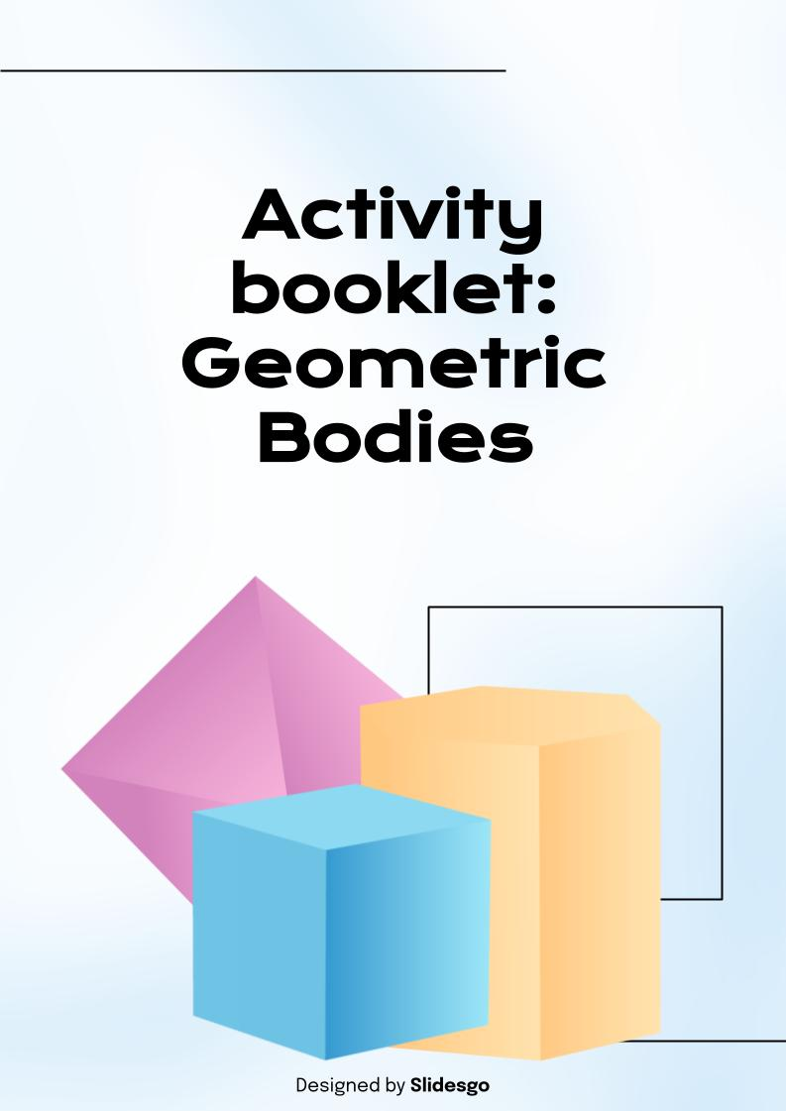
Instructions for printing: A4
Important note: In this template you will find downloadable slides. You can modify them to your liking and then download them as a .pdf file. This way, you’ll have a tailor-made version on your computer
For regular A4 version
Modify or add text and images if needed
Delete all the slides after the “Thanks” slide
Click File > Download > PDF Document
It will be downloaded to your computer
Now let's continue with the print settings!
Print with Adobe Acrobat
Open the downloaded PDF with Adobe Acrobat
Go to File > Print or press CTRL + P (Windows) / CMD + P (MAC)
Select these parameters
1. Select your printer
2. Check if you want to print it in black and white
3. ‘Actual size’
4. Select ‘Portrait’
Designed by Slidesgo

Slide 3
Table
of contents
01
02
Recap:
What are the geometric bodies?
Activities
Designed by Slidesgo

Slide 4


01
Recap
Designed by Slidesgo

Slide 5
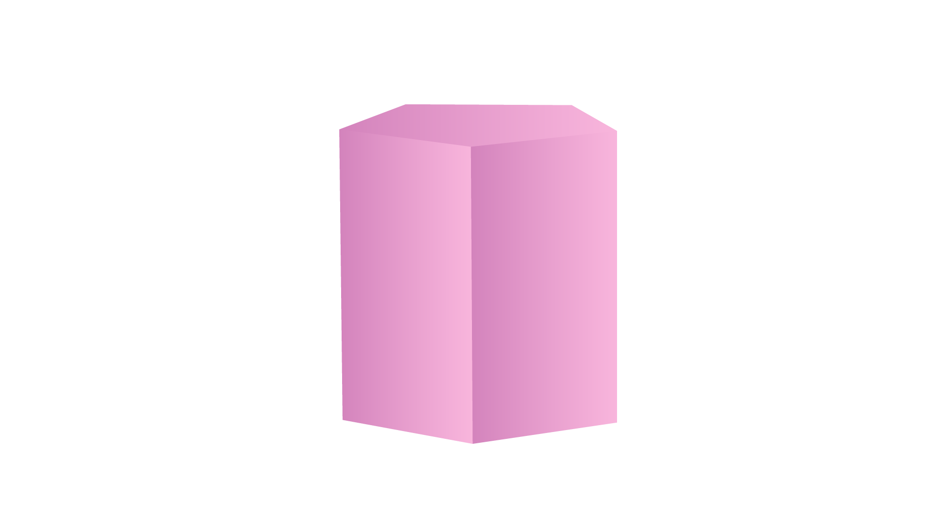

What are the geometric
bodies?
The geometric bodies that we are going to work with in this booklet are:
Cylinder
Prism
Sphere
Pyramid
Designed by Slidesgo

Slide 6

What are the geometric
bodies?
The geometric bodies that we are going to work with in this booklet are:
Cone
Cube
Designed by Slidesgo

Slide 7
02
Activities
Designed by Slidesgo

Slide 8
Activity 1
Mark the geometric bodies that can roll with an X:
Designed by Slidesgo

Slide 9

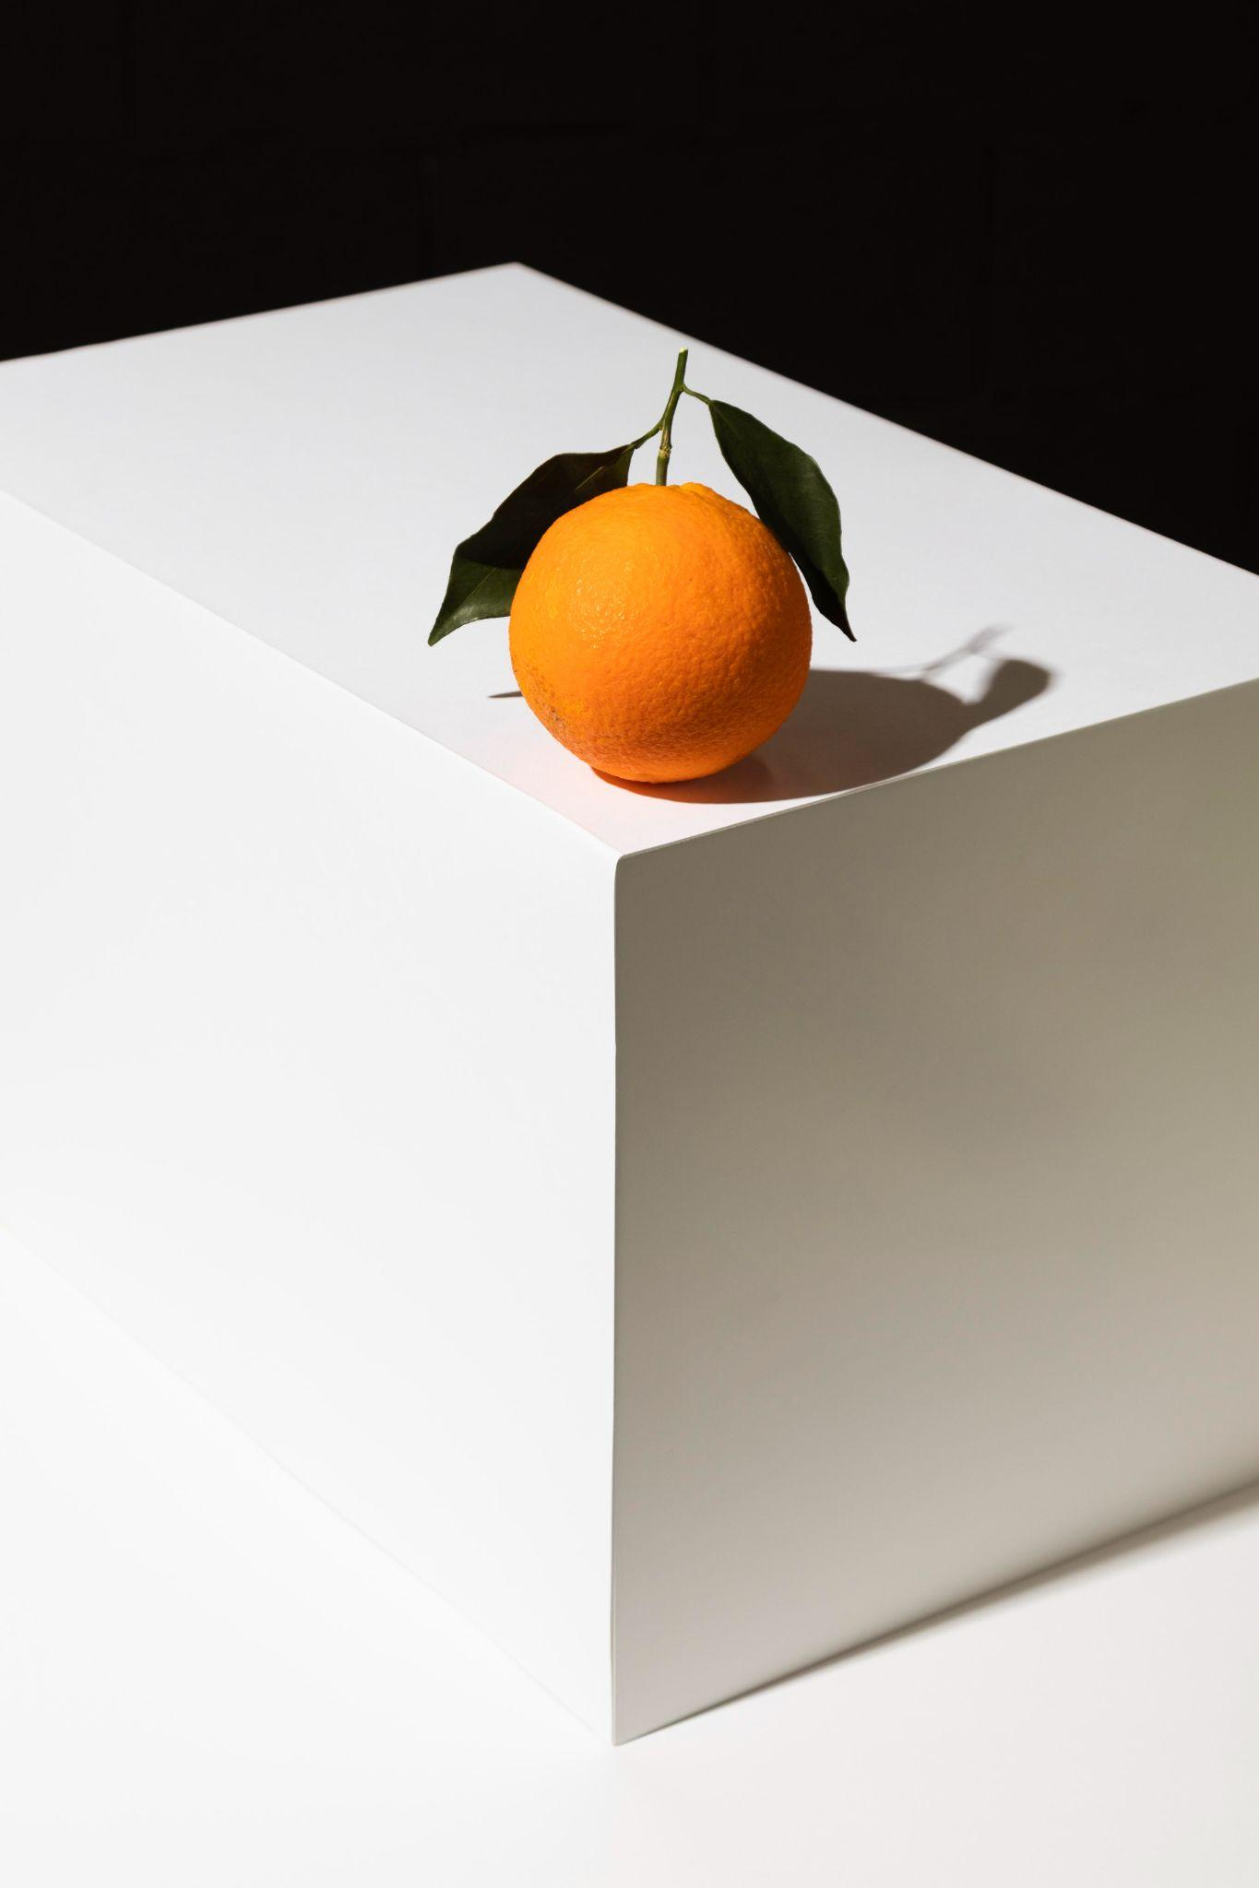
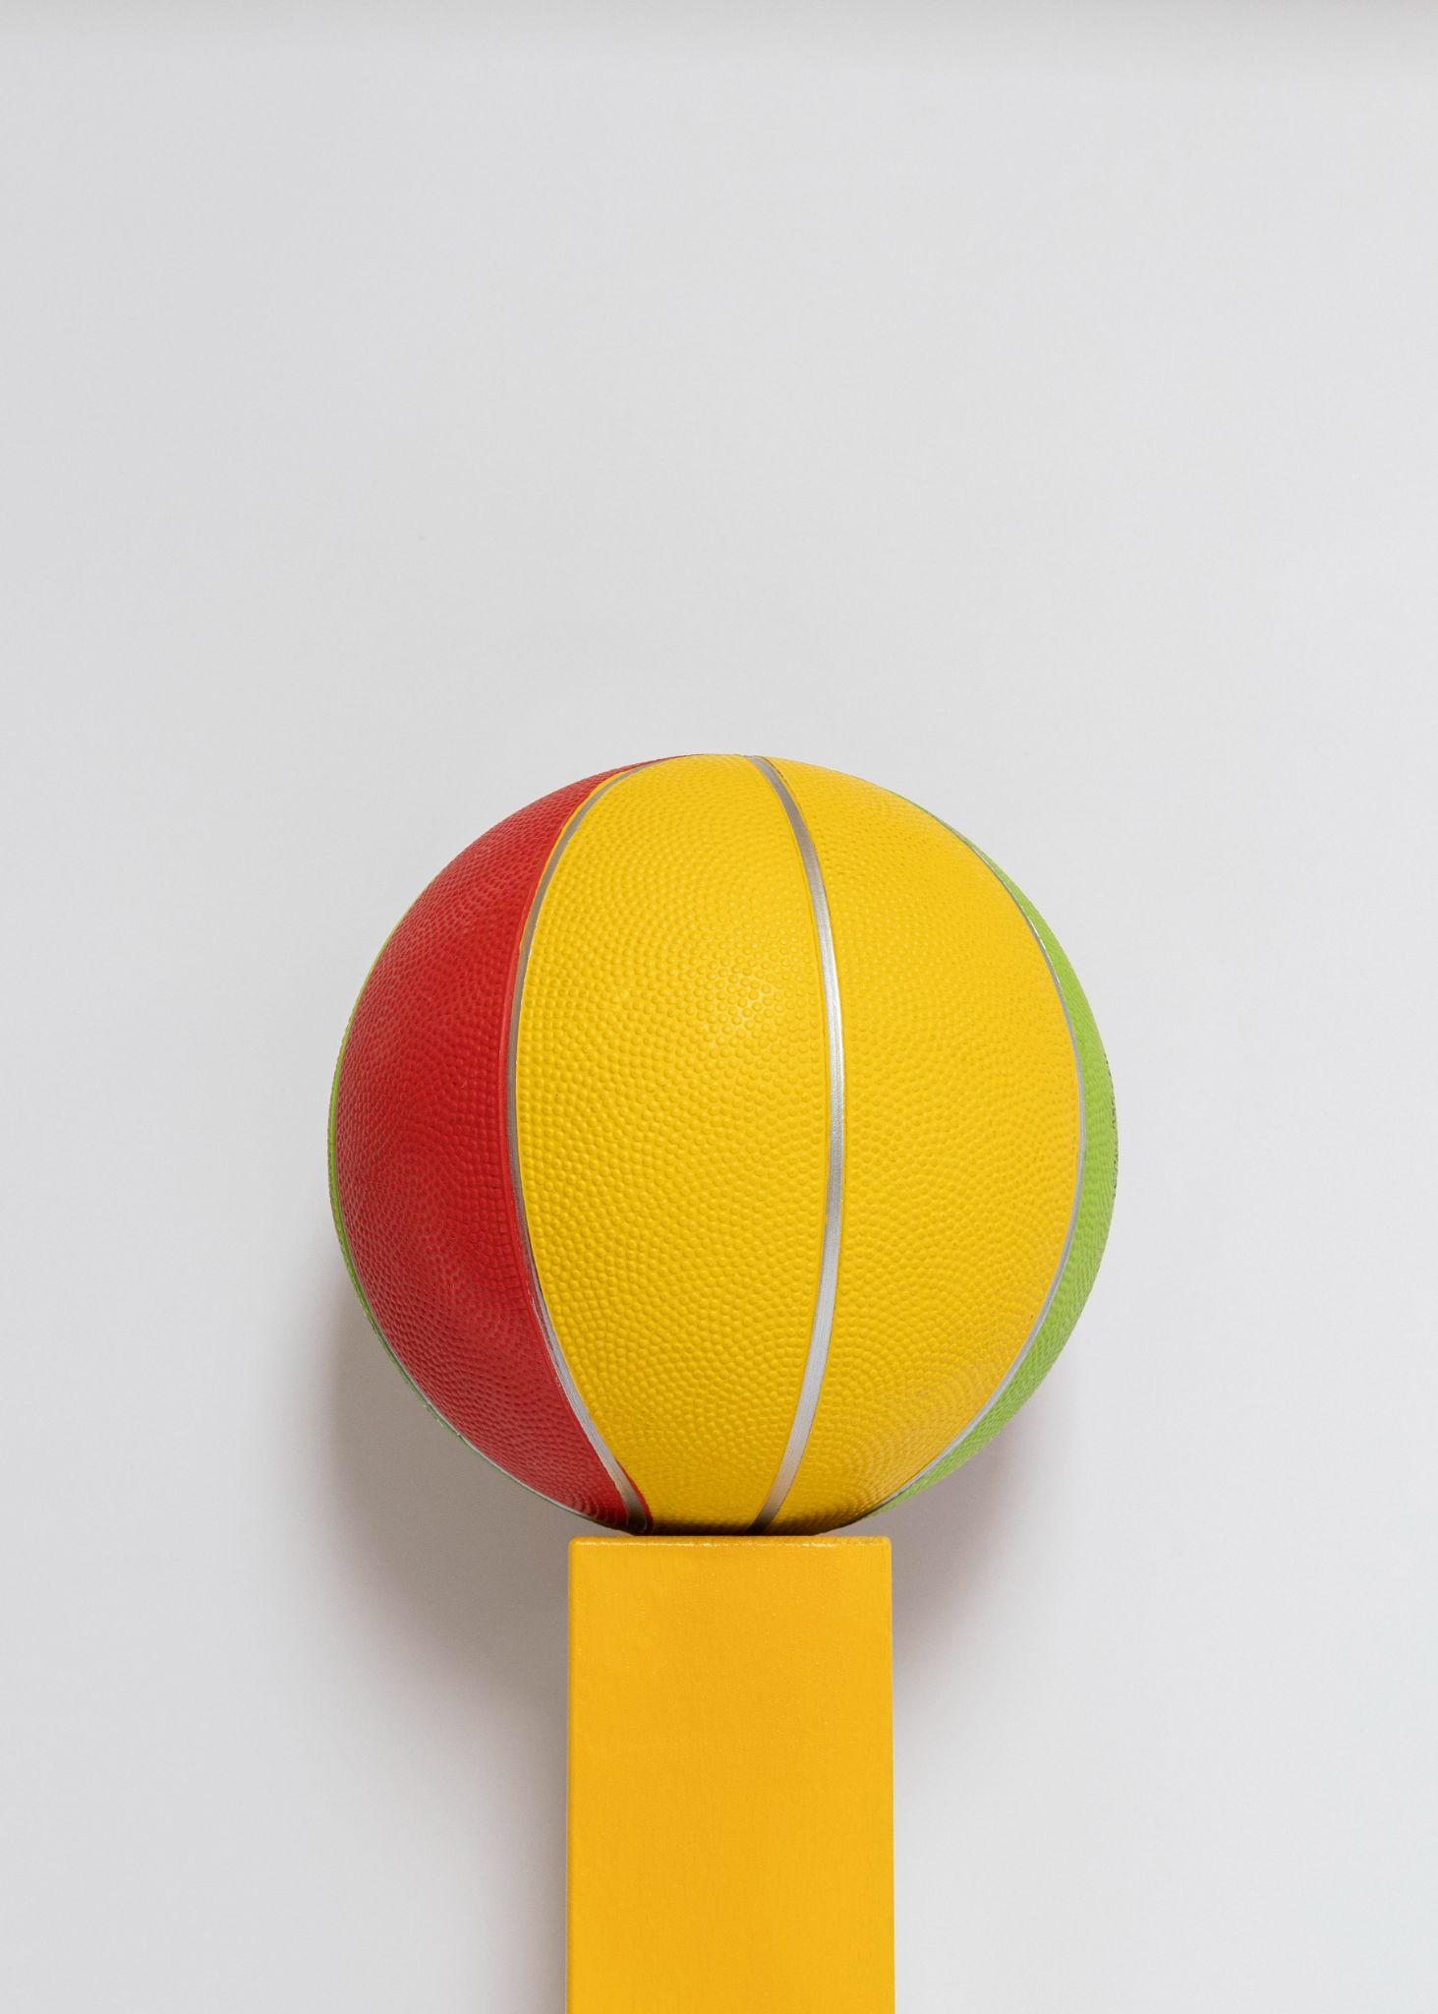
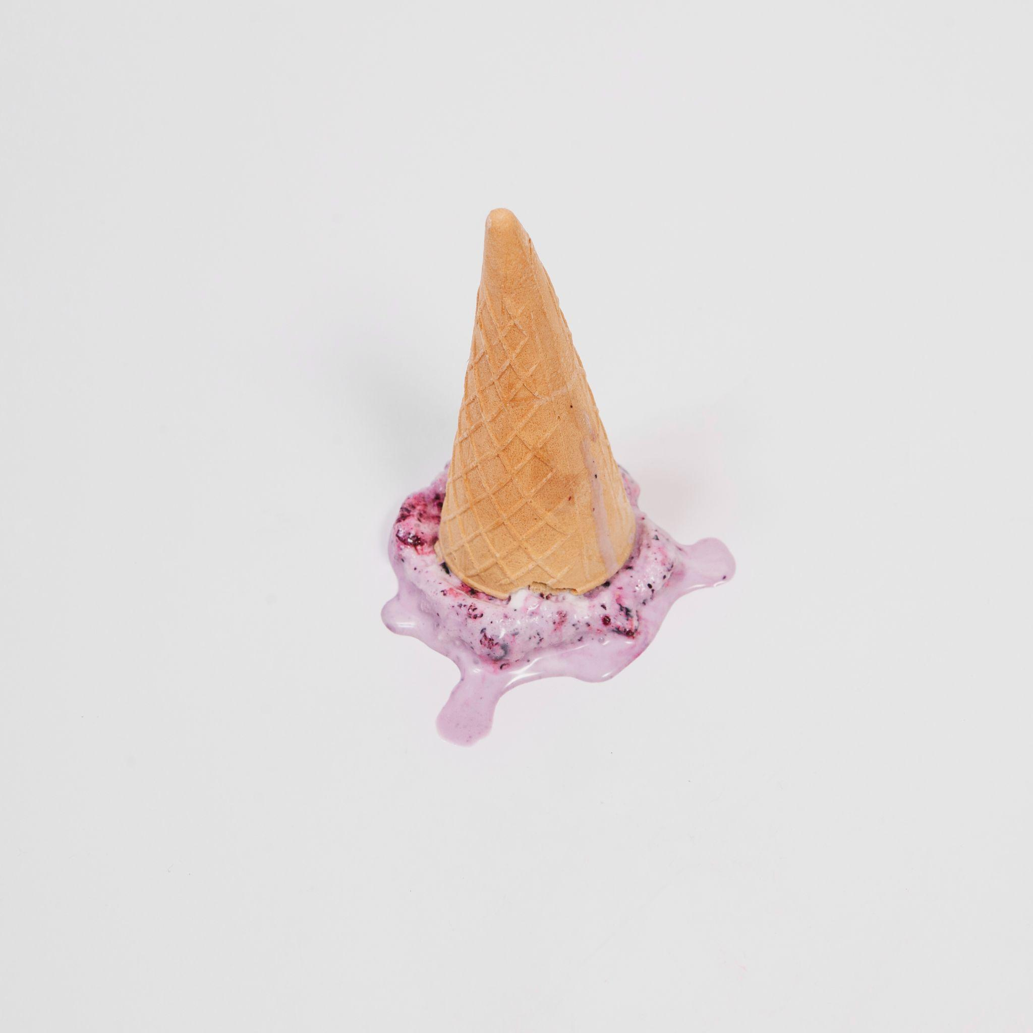

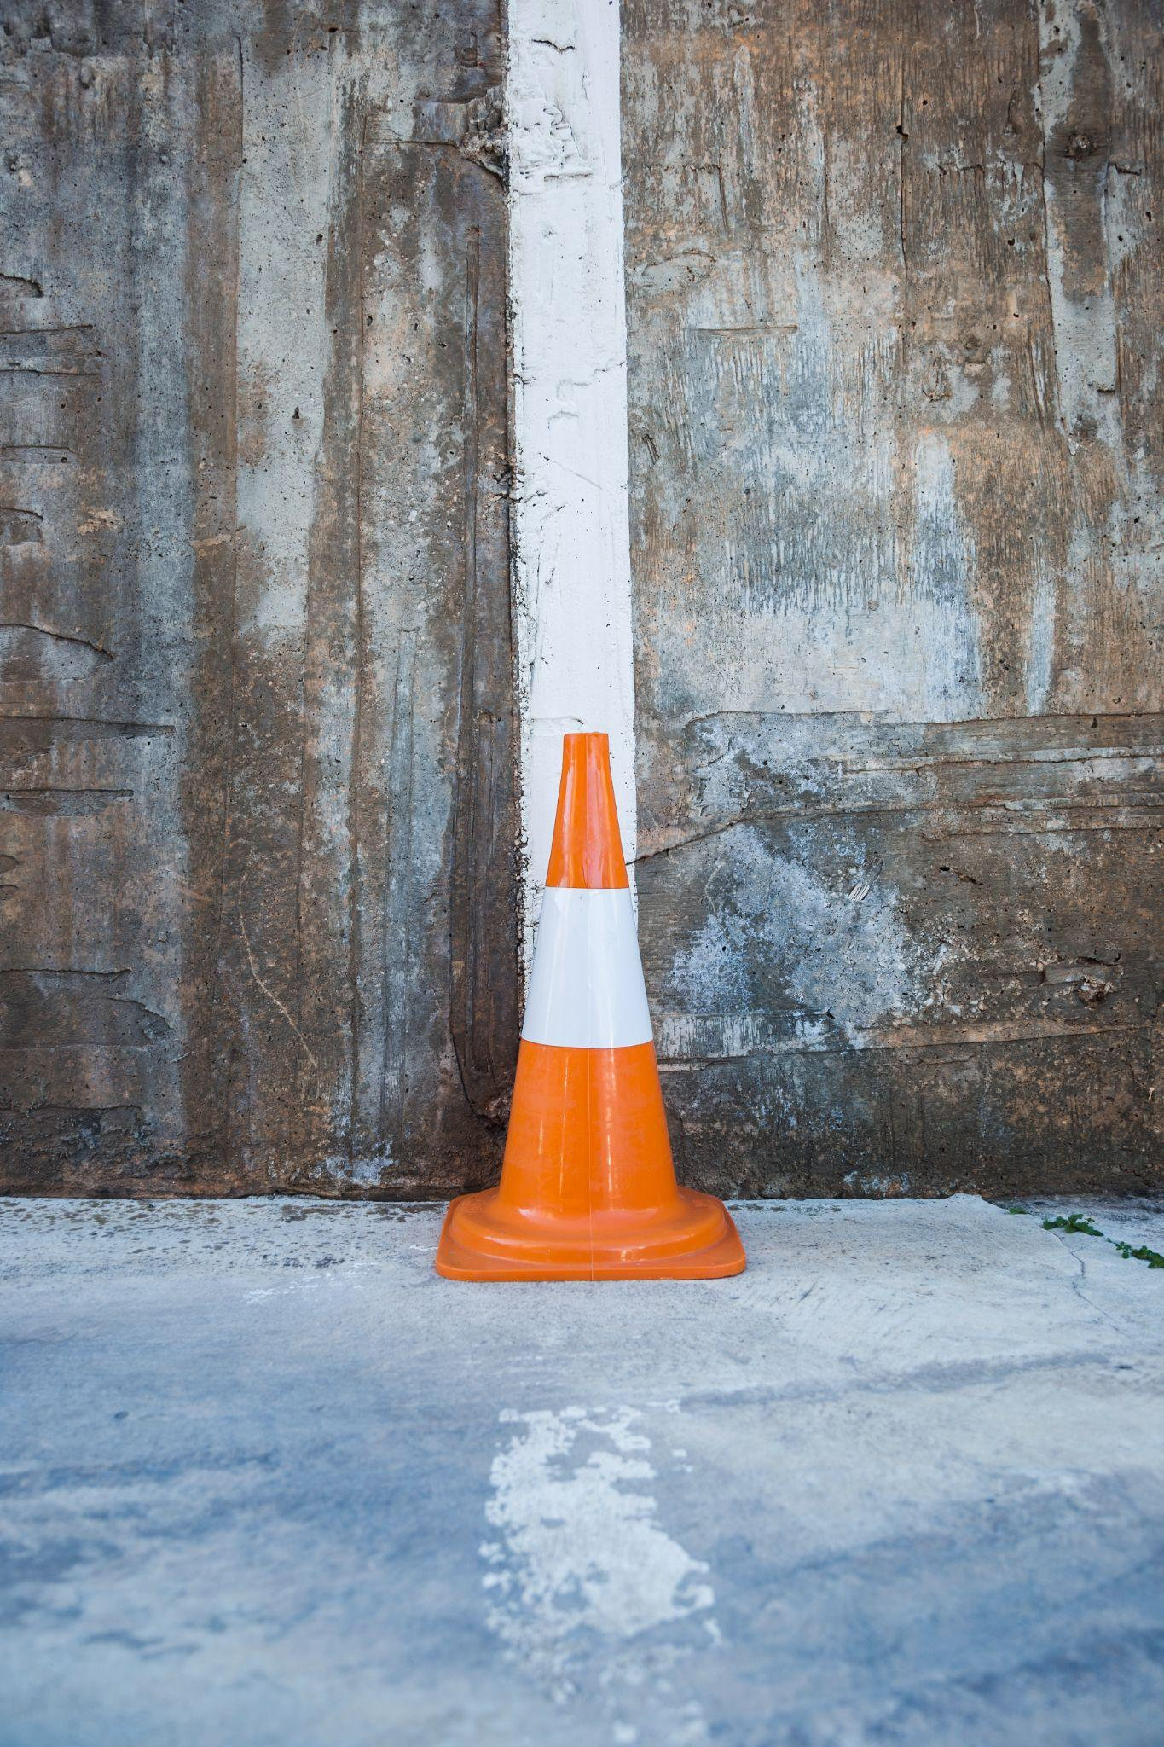
Activity 2
Classify the objects according to their resemblance to a geometric body:
Cube | Sphere | Cone
Designed by Slidesgo

Slide 10
Activity 3
Draw an object with the shape indicated on the left side:
Prism
Cube
Cone
Designed by Slidesgo

Slide 11
Activity 4
Draw an object with the shape indicated on the left side:
Sphere
Pyramid
Cylinder
Designed by Slidesgo

Slide 12
Activity 5
Answer true or false to the following statements:
The base of the cone is square
All prisms are pyramids
Round bodies have flat faces
The cylinder has all flat parts
Geometric bodies are elements that occupy a place in space
Designed by Slidesgo

Slide 13
Activity 6
Do the following word search and find the following words: Prism, Cube, Cylinder, Sphere, body, geometric, Cone and Pyramid
j | u | s | u | c | c | g | p | d | d
c | d | p | w | o | u | i | h | l | f
y | p | h | k | n | b | o | d | y | m
l | r | e | t | e | e | e | n | u | w
i | i | r | p | y | r | a | m | i | d
n | s | e | l | h | g | h | n | v | u
d | m | l | o | x | g | h | d | r | g
e | g | e | o | m | e | t | r | i | c
r | z | a | u | l | a | o | k | x | t
l | d | r | l | d | u | j | c | p | q
Designed by Slidesgo

Slide 14
Activity 7
Connect with a line the geometric body with the corresponding image:
Cube
Rectangular box
Sphere
Tent
Pyramid
Tennis ball
Cone
Birthday hat
Cylinder
Dice
Prism
Battery
Designed by Slidesgo

Slide 15
Activity 8
Identify and write the name of the decomposed geometric body
Designed by Slidesgo

Slide 16
Activity 9
Memotest of geometric bodies. Find the pair of geometric bodies (Prism, Cube, Cone, Sphere, Cylinder, Pyramid)
Designed by Slidesgo

Slide 17
Activity 10
Roulette. Find an object in the classroom in the shape of the geometric body that appears on the roulette wheel. To make the roulette you can cut out the circle and the arrow and pin them together. Spin it and start playing!
Sphere
Cube
Cone
Rhombus
Prism
Cylinder
Cylinder
Pyramid
Sphere
Cube
Designed by Slidesgo

Slide 18
Activity 11
Draw your favorite geometric body
Designed by Slidesgo

Slide 19
Thanks!
Any questions?
youremail@freepik.com
+34 654 321 432
yourwebsite.com
Please, keep this slide as attribution
Designed by Slidesgo

Slide 20

Alternative resources
Here’s an assortment of alternative resources whose style fits that of this template:
Vectors:
Designed by Slidesgo

Slide 21
Resources
Did you like the resources in this template? Get them for free on our other websites:
Vectors:
Solid body transparent set
Fortune wheel flat style
Fotos
Falling yellow dices yellow background
Traffic cone against wall
High angle orange podium
Front view basketball
Falling ice cream wafer cup
Eid al fitr concept with muslim man holding present boxes
3d geometrical shapes banner
Designed by Slidesgo

Slide 22
Instructions for use
If you have a free account, in order to use this template, you must credit Slidesgo by keeping the Thanks slide. Please refer to the next slide to read the instructions for premium users.
As a free user, you are allowed to:
- Modify this template.
- Use it for both personal and commercial projects.
You are not allowed to:
- Sublicense, sell or rent any of Slidesgo Content (or a modified version of Slidesgo Content).
- Distribute Slidesgo Content unless it has been expressly authorized by Slidesgo.
- Include Slidesgo Content in an online or offline database or file.
- Offer Slidesgo templates (or modified versions of Slidesgo templates) for download.
- Acquire the copyright of Slidesgo Content.
For more information about editing slides, please read our FAQs
or visit our blog:
https://slidesgo.com/faqs and https://slidesgo.com/slidesgo-school

Slide 23
Instructions for use (premium users)
As a Premium user, you can use this template without attributing Slidesgo or keeping the "Thanks" slide.
You are allowed to:
Modify this template.
Use it for both personal and commercial purposes.
Hide or delete the “Thanks” slide and the mention to Slidesgo in the credits.
Share this template in an editable format with people who are not part of your team.
You are not allowed to:
Sublicense, sell or rent this Slidesgo Template (or a modified version of this Slidesgo Template).
Distribute this Slidesgo Template (or a modified version of this Slidesgo Template) or include it in a database or in any other product or service that offers downloadable images, icons or presentations that may be subject to distribution or resale.
Use any of the elements that are part of this Slidesgo Template in an isolated and separated way from this Template.
Register any of the elements that are part of this template as a trademark or logo, or register it as a work in an intellectual property registry or similar.
For more information about editing slides, please read our FAQs
or visit our blog:
https://slidesgo.com/faqs and https://slidesgo.com/slidesgo-school

Slide 24
Fonts & colors used
This presentation has been made using the following fonts:
Krona One
(https://fonts.google.com/specimen/Krona+One)
Epiloque
(https://fonts.google.com/specimen/Epilogue)
#000000
#ffffff
#56c569
#fdd592
#d897bb
#4ec2df

Slide 25





Storyset
Create your Story with our illustrated concepts. Choose the style you like the most, edit its colors, pick the background and layers you want to show and bring them to life with the animator panel! It will boost your presentation. Check out how it works.
Pana
Amico
Bro
Rafiki
Cuate

Slide 26
Use our editable graphic resources...
You can easily resize these resources without losing quality. To change the color, just ungroup the resource and click on the object you want to change. Then, click on the paint bucket and select the color you want. Group the resource again when you’re done. You can also look for more infographics on Slidesgo.

Slide 29
PHASE 1
JANUARY
FEBRUARY
MARCH
APRIL
MAY
JUNE
Task 1
Task 2
PHASE 2
Task 1
Task 2
PHASE 1
JANUARY
FEBRUARY
MARCH
APRIL
Task 1
Task 2

Slide 32
...and our sets of editable icons
You can resize these icons without losing quality.
You can change the stroke and fill color; just select the icon and click on the paint bucket/pen.
In Google Slides, you can also use Flaticon’s extension, allowing you to customize and add even more icons.

Slide 33
Educational Icons
Medical Icons

Slide 34
Business Icons
Teamwork Icons

Slide 35
Help & Support Icons
Avatar Icons

Slide 36
Creative Process
Performing Arts Icons

Slide 37
Nature Icons

Slide 38
SEO & Marketing Icons

Slide 39


